Slide 1
Thoracic Aortic Aneurysm Development is Dependent on Membrane Type-1 Matrix Metalloproteinase Activity and Abundance Ying Xiong¹, Rupak Mukherjee¹, Sarah L. Lieser¹, Adam W, Akerman³, Robert E. Stroud¹, Elizabeth K. Nadeau¹, Francis G. Spinale², John S. Ikonomidis³, Jeffrey A. Jones^{1,4*}
RESEARCH ARTICLE
American Journal of Physiology
Heart and Circulatory of Physiology

Slide 2
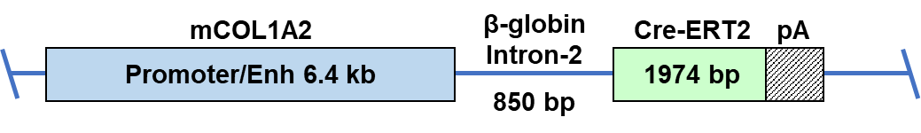
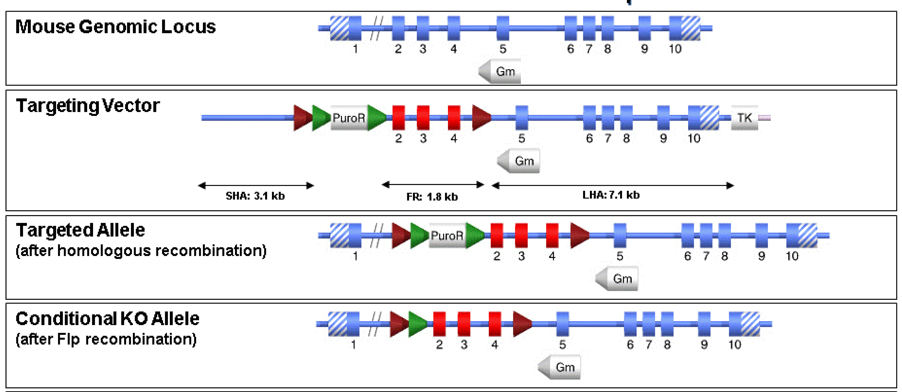
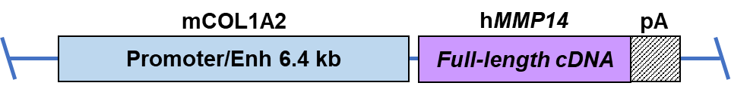
Supplemental Figure S1
A.
B.
C.
Supplemental Figure S1. Constructs used to generate the fibroblast-specific tamoxifen-inducible MT1-MMP knockout mouse (Col1A2-Cre(ERT2) x MT1-MMP-floxed) and the Fibroblast-MT1-MMP over expressing mice (FbMT1-MMP). (A) The Col1A2-Cre(ERT2) transgenic construct was designed by combining the 6.4 kb fibroblast-specific murine pro-alpha2(I) collagen (mCOL1A2) promoter/enhancer fragment (as described in Bou-Gharios et al., J Cell Biol, 134,1996, 1333 and Denton et al., Arthritis & Rheumatism, 44, 2001, 712), an 850 bp human β-globin intron-2 , and 1974 bp of the tamoxifen-inducible Cre recombinase (Cre-ERT2) ORF, followed by 221 bp SV40 polyA sequence. The construct was created in a modified pGL3 vector back-bone (Promega) for pronuclear injection into embryos from C57BL/6 mice, by TaconicArtemis, Germany. (B) The floxed-MT1-MMP mouse was created by homologous recombination. The targeting vector contained loxP sites flanking a positive selection marker (Puromycin resistance (PuroR), flanked by FRT sites), and murine Mmp14 exons 2-4. After homologous recombination, the PuroR selection marker was removed by Flp recombination, to generate the Conditional Knockout Allele. The two mouse strains were bred and mice that were Col1A2-Cre(ERT2)⁺ x floxed-Mmp14^{+/+} were utilized in our studies as indicated. (C) The fibroblast MT1-MMP overexpressing mice (FbMT1-MMP) were generated using a transgenic approach. The construct was created using the same 6.4 kb fibroblast-specific murine pro-alpha2(I) collagen (mCOL1A2) promoter/enhancer fragment, the full-length human-MMP14 cDNA, and an SV40-polyA sequence. This was created in the same modified pGL3 vector backbone for pronuclear injection into embryos from FVB mice, by TaconicArtemis, Germany.

Slide 3
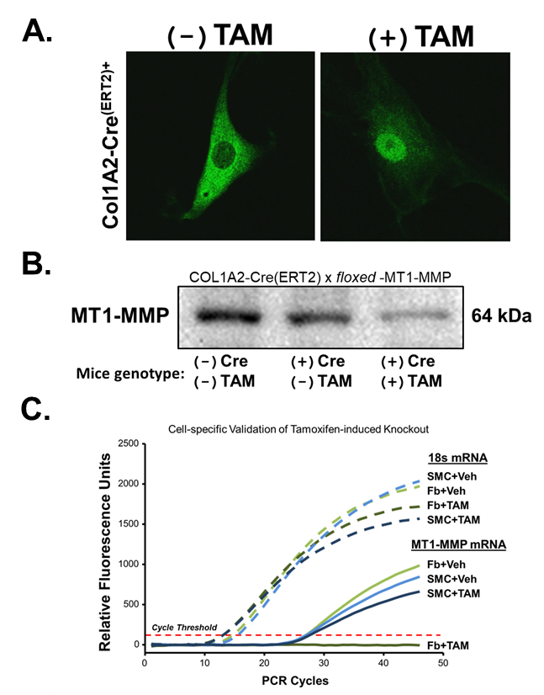
Supplemental Figure S2
Supplemental Figure S2. Validation of Col1A2-Cre(ERT2) mediated knockout of MT1-MMP validated at the protein (Western blotting) and gene levels (qPCR). (A) Col1A2-Cre(ERT2) positive fibroblasts were treated with Tamoxifen (TAM), fixed and stained with anti-Cre antibody (green AlexaFluor488). Results show that Cre-ERT2 trans-locates to the nucleus of TAM-treated cells. (B) Col1A2-Cre(ERT2) x floxed-MT1-MMP mice were treated daily for 5 days with TAM (75 mg/kg /day ip, corn oil). The aorta was excised at day 10 and tissue lysates immunoblotted for MT1-MMP. Results confirmed Cre-mediated conditional knockout of MT1-MMP protein in the descending thoracic aortas (n=3/group). (C) qPCR for MT1-MMP expression in isolated aortic fibroblast and smooth muscle cell lines (n=3 ea) from TAM-treated FbMT1KO mice, confirmed that MT1-MMP was only knocked out in fibroblasts but not in smooth muscle cells.

Slide 4
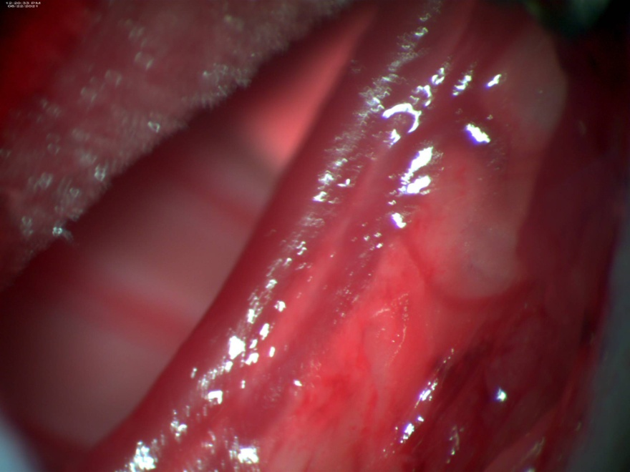
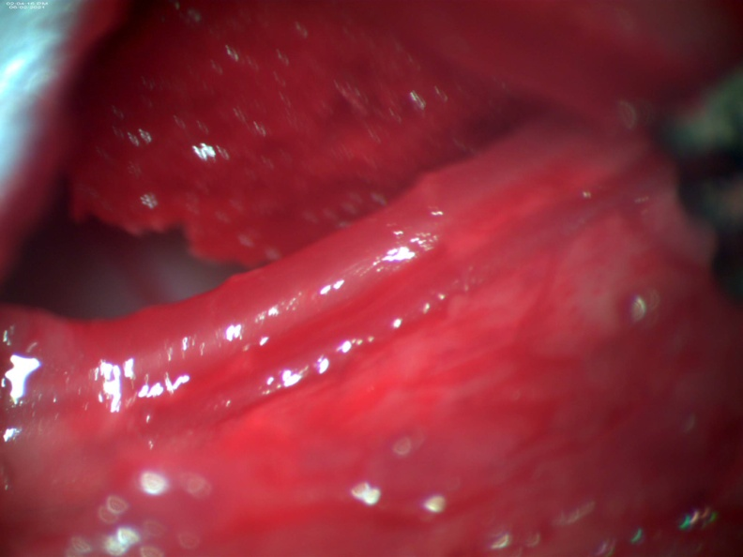
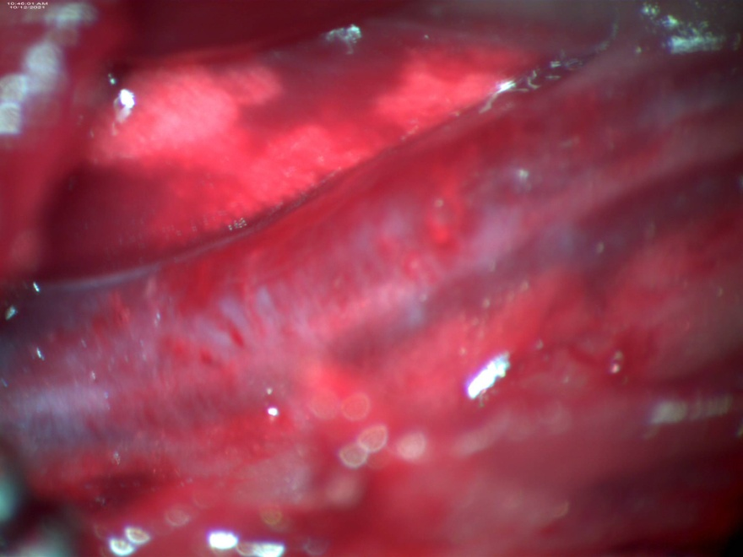
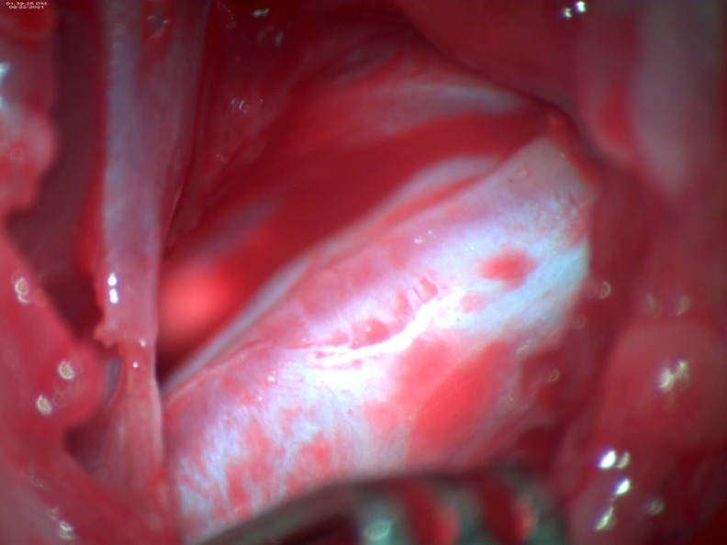
Supplemental Figure S3
A.
Control
FbMT1-KO
Baseline
TAA 16w
B.
Control
FbMT1KO
0 4w 8w 16w
0 4w 8w 16w
MT1-MMP
β-actin
Supplemental Figure S3. Control and FbMT1KO mice were treated daily for 5 days with TAM (75 mg/kg /day ip, corn oil). Ten days later, TAA surgery was performed on these mice. (A) Representative images of aortas showed that TAM-administration prior to TAA surgery resulted in excessive scar tissue on aortas of FbMT1KO mice at 16w post-TAA. (B) The aorta was excised at indicated time points post-TAA, and homogenates of three aortas combined for each group were immunoblotted for MT1-MMP and β-actin. Results indicated that knockout of MT1-MMP in aortic fibroblasts suppressed the increase of MT1-MMP abundance during TAA progression.

Slide 5
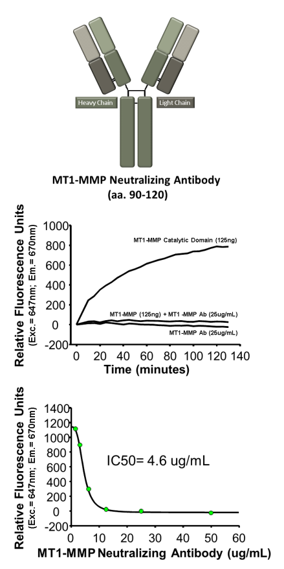
Supplemental Figure S4
Supplemental Figure S4. Validation of MT1-MMP inhibitory antibody. A custom-made antibody was designed to bind within the catalytic domain of MT1-MMP (aa 90-120). The antibody was validated in vitro by co-incubating with human recombinant MT1-MMP catalytic domain and assessing MT1-MMP activity using a commercially available quenched fluorogenic peptide substrate. The results (top) revealed significant inhibition of MT1-MMP activity in the presence of the antibody, with an IC₅₀ below 5 µg/ml (bottom).

